Slide 1


Customizations and Integrations
Customizing Stone Edge & 3rd Party Integrations
Presenters
Barney Stone, Barney Stone Software
Steve Cisick, Technology Copilot, LLC

Slide 2











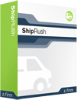







From StoneEdge.com, 2011

Slide 3










Today’s Conference

Slide 4
Today’s Conference
Payment Processing
Shipping optimization
Business development / consulting
International shipping services
Customer reviews
Trust services
Shopping carts & cart integrations
Network, IT and security services
Off-the-shelf add-ons for Stone Edge
Custom programming services

Slide 5



















































MonsoonCommerce.com

Slide 6
Examples of custom code written for Stone Edge users
Check imported orders for:
Restricted items
Shipping & PO Box issues
Best shipping method
Duplicate orders
AVS and CVV problems
Missing customization data
Which drop shipper to use
etc.

Slide 7
Examples of custom code written for Stone Edge users
Checks when approving orders:
Duplicate PO numbers
Missing address fields
Restricted items
Payment issues
etc.

Slide 8
Examples of custom code written for Stone Edge users
EDI support
Import orders
Export order status and tracking data

Slide 9
Examples of custom code written for Stone Edge users
Import shipping costs
Update kit costs
Get current vendor QOH

Slide 10
Examples of custom code written for Stone Edge users
Send shipping data to common carriers
Display ship-to address in Google Maps
Multiple warehouse support

Slide 11
Off-the Shelf Stone Edge Add-Ons
Advanced User Interface
Advanced View Orders

Slide 12
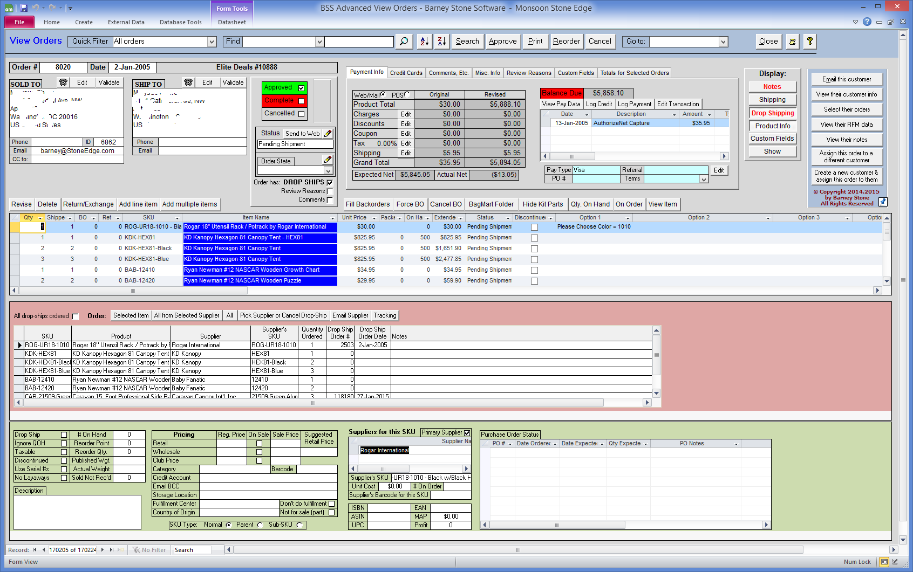
Off-the Shelf Stone Edge Add-Ons

Slide 13
Off-the Shelf Stone Edge Add-Ons
Advanced User Interface
Advanced View Orders
Advanced Customer Service

Slide 14
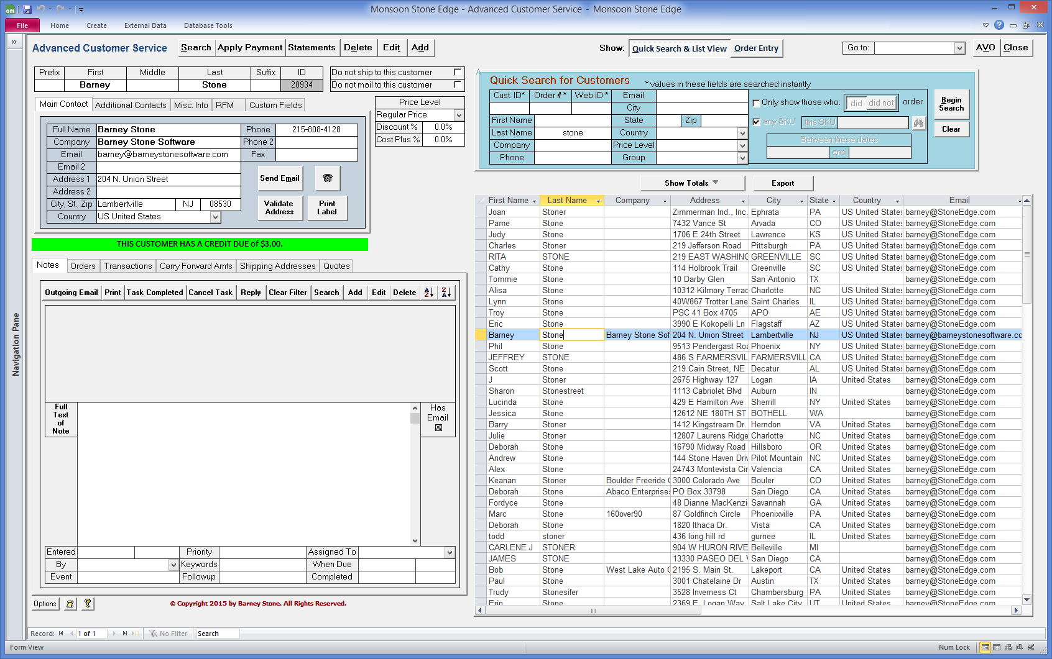
Off-the Shelf Stone Edge Add-Ons

Slide 15
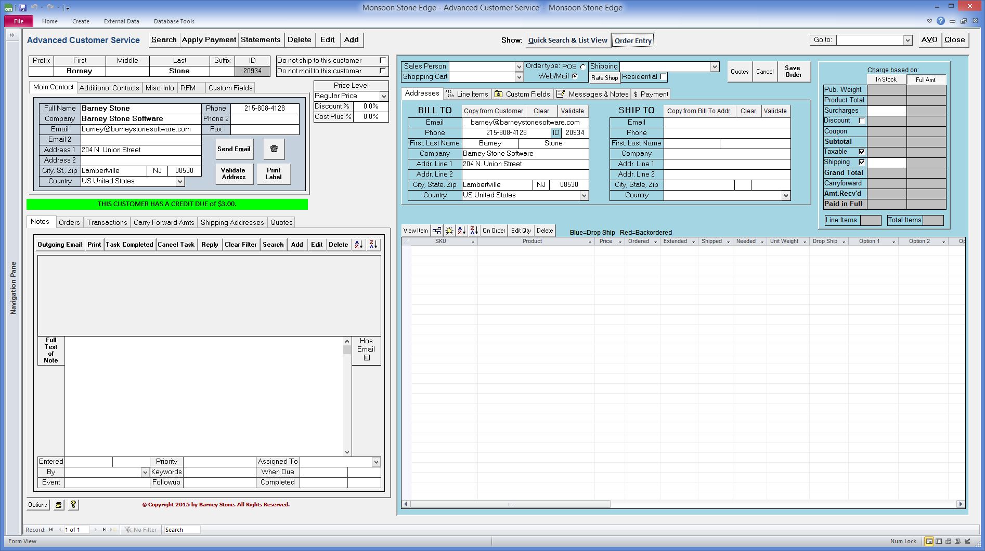
Off-the Shelf Stone Edge Add-Ons

Slide 16
Off-the Shelf Stone Edge Add-Ons
Advanced User Interface
Advanced View Orders
Advanced Customer Service
Wizards
Order Export Wizard
Quick Filter Wizard
Barcoders.com Utilities
Multiple Location Support
QOH Updates

Slide 17
Off-the Shelf Stone Edge Add-Ons
Advanced User Interface
Advanced View Orders
Advanced Customer Service
Wizards
Order Export Wizard
Quick Filter Wizard

Slide 18
Agenda
Why customize?
Where to customize?
Dangers to customizations
How to customize?
Example integrations/customizations
CommCon 2015
Notes:
Why
Barney already touched up on this a bit
Where
Where can it be done?
Dangers
How
Examples

Slide 19
Why Customize?
Extend application feature / functionality
Get immediate benefits without waiting for software vendor to add
Gain competitive advantage
CommCon 2015
Notes:
Extend application
A number of people I work with just need some simple changes made that can make a big difference.
Immediate Benefits
No need to wait for Monsoon to add feature/functionality.
Competitive Advantage
Something custom can give you a leg up on competition

Slide 20
Where to Customize?
Inside of Stone Edge
  Update VBA code
  Update MS Access forms, reports, etc.
Outside of Stone Edge
  Directly connect to Stone Edge database
CommCon 2015
Notes:
Inside
Outside

Slide 21
Dangers to Customizations
Customization causes big problems
  Developer unfamiliar
  Junior developer
  Neighbor who knows MS Access
Support difficulty
  Software vendor
  Original developer MIA
Upgrade difficulty
  So many customizations, locked into old version.
  Cost to convert customization high
CommCon 2015
Notes:
Big Problems – Corrupt data, etc.
We see this a lot – where we pick up the mess for failed customizations, horrified…
Not a lot of people out there that do customizations.
Maybe $ is an issue – Junior developer may not be a good choice.
Worst case – Your neighbor knows MS Access….
Support difficulty
Vendor doesn’t want or can’t support because of changes made.
Original developer went back to their day job or simply cannot be found.
Upgrade difficulty
I’m not a fan of big customizations.. As I know that too many changes can …
Too many changes can make upgrading difficult.
Cost becomes too high to upgrade…

Slide 22
How to Customize?
Inside Stone Edge
  Use Custom ‘hooks’ to embed custom code.
  Leave plenty of documentation.
  Avoid changing ‘base’ code.
Outside Stone Edge
  Avoid trying to recreate ugly processes like order imports or anything related to purchase orders
CommCon 2015
Notes:
Inside
Using custom hooks makes the customizations portable.
Keep documentation on the requirements/what they built and documentation for how it was done.
Base code changes are usually a last resort – Base code changes are ones that need to be re-integrated when version upgrades are made.
Outside
Use the database but avoid trying to recreate some of the core functionality like order importing / PO Management.

Slide 23
Technology Copilot
Shopping Cart Integrations
Shopping Cart Integrations
  Sears
  Vendor Central
  Rakuten
  OverStock
  Commerce Hub
  Wayfair
  Zazzle
  Houzz
  New Egg
  Etsy
  Whole Foods
CommCon 2015

Slide 24
Technology Copilot
Shipping Software Integrations
Shipping
  Move Method (RateLinx)
  Dynamic Shipping (Express1)
  TrueShip
  OnTrac
  Parcel Pro
CommCon 2015

Slide 25
Technology Copilot
FBA Integration
FBA
  Order Import
  Returns
  Inventory Adjustments
  Reconciliation
CommCon 2015

Slide 26
Technology Copilot
Miscellaneous
Orders
  Split orders
Purchase Orders
  Auto associate orders to items on PO.
  Import and Export
Inventory
  Send Kit/Drop ship quantity on hand to cart
  Auto create / auto break assemblies
Invoicing
  Invoice by PO
CommCon 2015

Slide 27

Q & A

